Slide 1
In Memoriam
Created by Russ Hodges
CLADEA Chair, 2007-2014

Slide 2
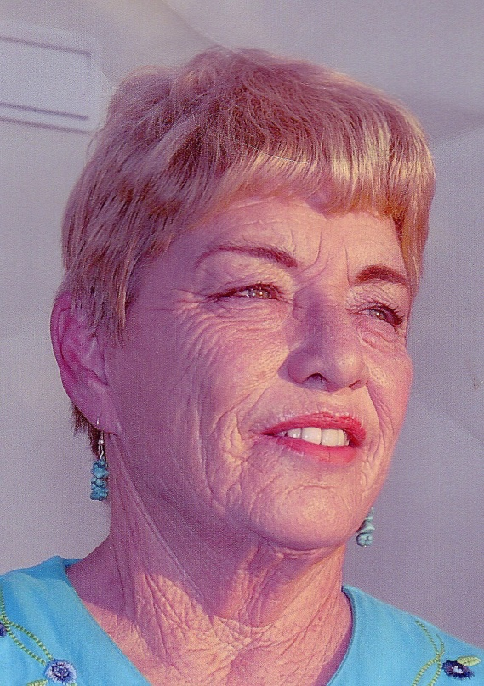
Kathy Carpenter, CLADEA Fellow
Director, Learning Academic Center / Faculty at University of Nebraska-Kearney
President and Treasurer of CRLA
1st President of the Heartland Chapter of CRLA
Prolific Scholar
“And who in the Heartland Chapter wasn't strong armed by Kathy to get more involved, to take a leadership position, and to get busy and work for CRLA? Even her presidential address was a call to service.”
Karen Agee, Reading and Learning Coordinator Emerita, University of North Iowa
Notes:
Grant Thornton LLP
1/2/2016
2

Slide 3
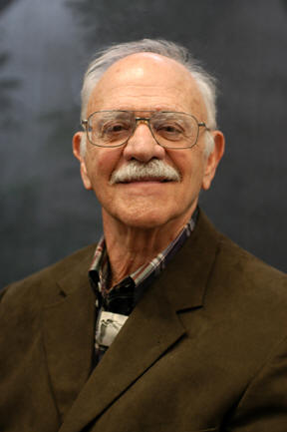
Frank Christ,
CLADEA Founding Fellow
Considered the “Father of Postsecondary Learning Assistance”
Director CSU-Long Beach Summer Institutes (1985-1989); Co-director/coordinator of the Arizona Winter Institute (1991-2003)
Co-founder and 2nd President of CRLA
Founder/Past Coordinator of the Learning Assistance Support Systems at California State University-Long Beach
Prolific Author with Six Study-Skills Textbooks
Co-creator of LSCHE Website
CRLA Awards: Rudy Anniversary Award, Long and Outstanding Service Award, Board Special Recognition Awards
“His energy was endless as he mentored us, taught us, and led us by example.”
Rick Sheets, Former Director, Learning Support Center , Paradise Valley Community College
Notes:
Grant Thornton LLP
1/2/2016
3

Slide 4
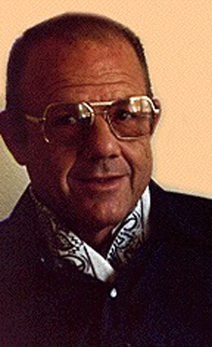
Gene Kerstiens,
CLADEA Founding Fellow
Professor of English/Reading and Associate Dean of Instruction, El Camino College, CA
Co-founder and 5th President of CRLA
Director of Andragogy Associates
Co-Author of the Study Behavior Inventory
Editor of the Review of Research in Developmental Education, Journal of College Reading and Learning, and Advisory Editor of the Journal of Reading
Recipient, CRLA’s Board Special Recognition Award (Jade Award 35th Anniversary Award), CRLA’s Long and Outstanding Service Award
“If I were to sum up Gene's professional life, a life of over 40 active years, I would use the following words: collegial, intellectually challenging, mentor, author, editor, administrator, researcher, critic, and above all a colleague--for many in developmental education and learning assistance, a caring friend.”
Frank L. Christ, Co-founder of CRLA
Notes:
Grant Thornton LLP
1/2/2016
4

Slide 5
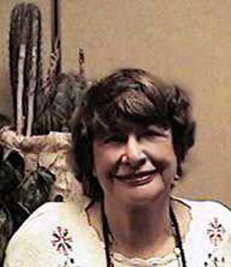
Martha Maxwell,
Envisioned CLADEA Fellows
& Founding Fellow
Over 50-Year Career & Pioneer in the Field
Founded and Directed Learning Centers at the American University, the University of Maryland, and the University of California at Berkeley
Prolific Scholar Including the Classic, Improving Student Learning Skills
“…Counselor, Teacher, Academic Advisor, Reading and Learning Disabilities Specialists, Researcher, Administrator, and Perennial Student” (in her own words)
“I wish that Martha could know the impact she has had on so many lives—not just on those like mine that she touched on a very personal level, but the butterfly effect, the enduring impact of operationalizing what it means to be truly student-centered.”
Jeanne Higbee, Professor and Senior Advisor of Research, University of Minnesota
Notes:
Grant Thornton LLP
1/2/2016
5

Slide 6
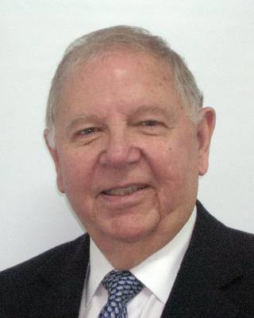
Robert McCabe, CLADEA Fellow
President, Miami Community College (1980-1995)
Led Miami Dade College from a Single Campus into Nation’s Largest Community College with Campuses Across South Florida
Author of No One to Waste: A Report to Public Decision-makers and Community College Leaders
Championed Developmental Education as a National Need; Led Educational Reform
Inductee, University of Miami’s Education Hall of Fame; Recipient of the American Association of Community Colleges’ Leadership Award; named MacArthur Fellow
“He wanted to make sure the community college had credibility and he changed everything he could possibly get a hold of.”
J. Terence Kelly, McCabe’s Former Vice President at Miami Dade and Chancellor at the Alamo Community College District in San Antonio.
Notes:
Grant Thornton LLP
1/2/2016
6

Slide 7
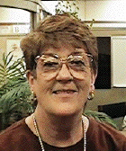
Karen Smith, CLADEA Founding Fellow
Designed, developed, and directed learning assistance centers at Rutgers University, Tulane University, and New Mexico State University.
CRLA Past President, New Mexico State Director,
International Reading Association member and New Mexico Chapter State President
Recipient, CRLA Long and Outstanding Service Award
“There are not enough words to adequately describe my relationship with Dr. Smith. She really believed in me. I don’t know what she saw, but when she said I could do anything—I believed her!”
Valerie Smith Stephens, Asst. Dean/Director Educational Opportunity Fund, Rutgers University
Notes:
Grant Thornton LLP
1/2/2016
7

Slide 8
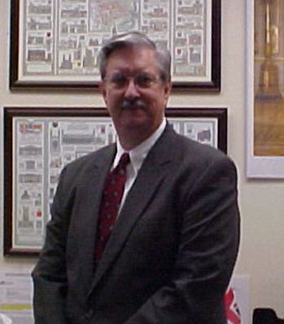
William G. White, Jr., CLADEA Fellow
Professor, Educational Leadership, Grambling State University
Held Two Doctorates
Award Winning & Prolific Scholar; Historian for the Field
Well Known for Research on Learning Support Center Physical Environments and Land-Grant Colleges.
Served as a Mentor at the Winter Institute
Recipient, Outstanding Service Award, NADE
“ Few people in the country have had such a profound influence on new doctoral researchers and practitioners within our field; I have become a better teacher and scholar because of his influence.”
Russ Hodges, Associate Professor, Texas State University,
CLADEA Chair, 2007-2014
Notes:
Grant Thornton LLP
1/2/2016
8

Slide 9
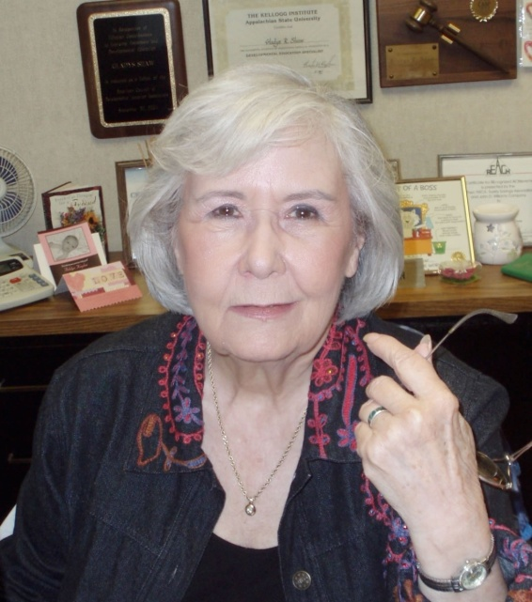
Gladys Shaw, CLADEA Fellow
Directed Programs for Upward Bound at University of Texas El Paso (UTEP), UTEP’s Tutoring and Learning Center, and Student Support Services for El Paso Community College
Co-created International Tutor Training Program Certification and created International Mentor Training Program Certification for CRLA
Author of NADE’s Self-Evaluation Guide for Tutoring Services.
Recipient, CRLA’s Special Recognition Award, Robert Griffin Award for Long & Outstanding Service, NADE’s Henry Young Award for Outstanding Service, and American College Personnel Association’s Award for Commission XVI’s Excellence as a Learning Assistance Practitioner
“Our Crown Jewel of Texas understood the tremendous difficulties that many of our citizens face and was relentless in eliminating barriers that impede college attendance and success. She knew that college provides hope, inspiration, and a better life for our citizenry. She lived her life dedicated to this end.”
Russ Hodges, Associate Professor, Texas State University
CLADEA Chair, 2007-2014
Notes:
Grant Thornton LLP
1/2/2016
9

